Slide 1
Introduction to Strategic Management
By; Nilantha Perera,

Slide 2
Discussion Questions
Define what is strategy
Define the characteristics of strategic decisions
Define what is strategic Management
Explain how strategic priorities vary by level: corporate, business and operational;
Understand the basic vocabulary of strategy
Understand what distinguishes strategic management from operational management
Define what is strategic Management
Explain the elements of exploring corporate strategy strategic model and understand how the relative importance of each element will vary with context and circumstances

Slide 3
Definition of Strategy
  Strategy is the direction and scope of an organisation over the long term, which achieves advantage in a changing environment through its configuration of resources and competences with the aim of fulfilling stakeholder expectations.

Slide 4
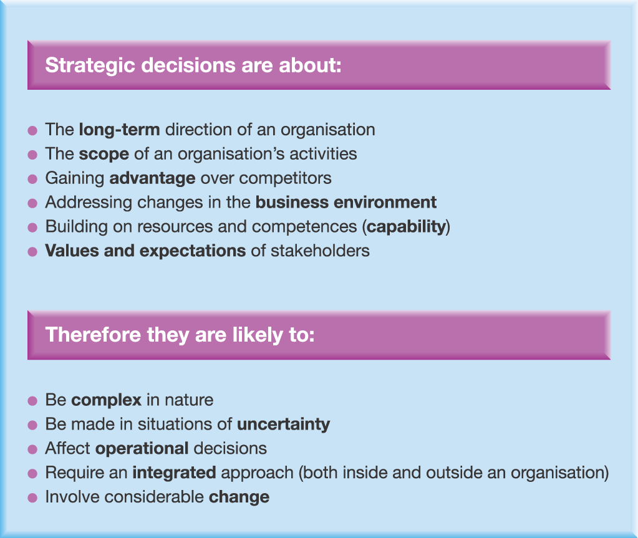
Strategic decisions
Exhibit 1.1
Notes:
Integrated approach: if the operations are not in line with strategy then the the strategy will fail
Change : heritage and culture issue in mergers and acquistions

Slide 5
LEVELS OF STRATEGY
Corporate level:
It is concerned with overall purpose and scope of organization and how values will be added to different parts of the business in organization
  Corporate level strategy is the basis of other strategic decisions
  Large decision scale
  Meet expectations of stakeholders

Slide 6
Business level (SBU)
It is about to complete successfully in particular market
  How competitive advantage over the customers can be achieved
  Strategic decisions here are related with strategic business units.
  SBU is unit of an organization for strategy making purpose

Slide 7
Operational
It is concerned with how the component parts of the organization deliver effectively the corporate and business level strategies in terms of resources, processes and people.

Slide 8
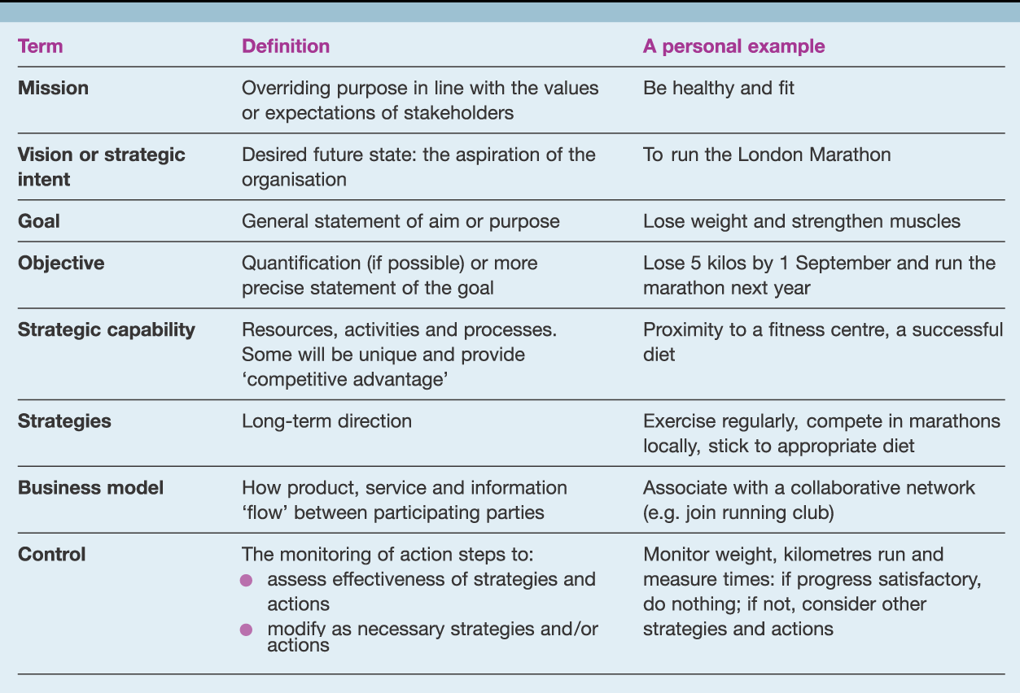
The vocabulary of strategy
Exhibit 1.2

Slide 9
The Vocabulary of Strategy
Mission – overriding purpose
Vision/strategic intent – desired future state
Goal – general statement of aim or purpose
Objective – quantification or more precise statement of goal
Strategic capability – resources, activities and processes
Business model – how product, service and information flow
Control – monitoring of action steps

Slide 10
Strategy and Operations
Strategic Management | Operational Management
Organisation-wide | Routinised
Conceptualisation of issues | Techniques and actions
Creating new directions | Managing existing resources
Developing new resources | Operating within existing strategy
Ambiguous/uncertain | Operationally specific
Long term | Day to day issues

Slide 11
Strategic Management
Strategic Management Understanding the strategic position of an organization, Strategic Choices for the future and turning strategy into action.
The scope of strategic management is greater than that of any one area of operational management.
Strategic management is concerned with complexity arising out of ambiguous and non routine situations with organization wide rather than operation specific implications

Slide 12
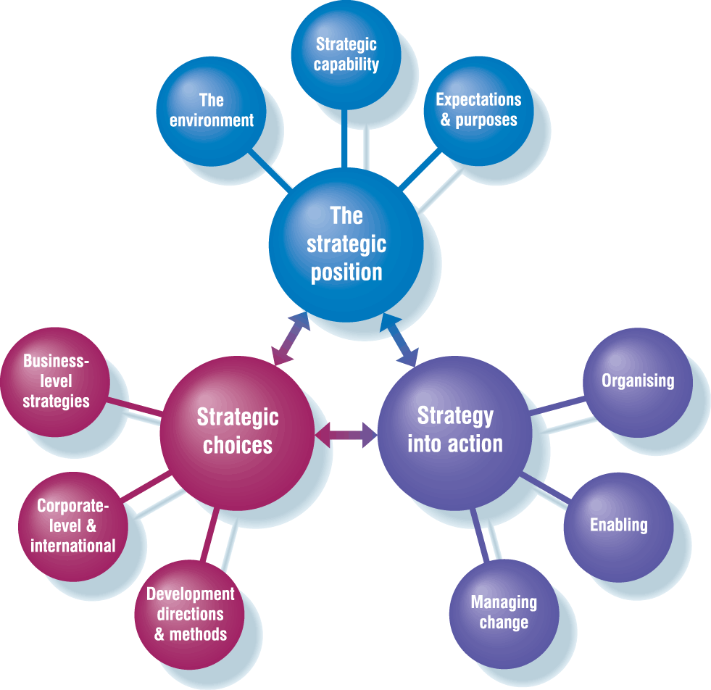
A model of the elements of strategic management
Exhibit 1.3

Slide 13
Strategic Position (1)
The strategic position is concerned with the impact on strategy of the external environment an organization`s strategic capabilities and expectation and influence from the stake holders.
The Organisation’s Environment
  Political Economic Social Technological Legal Environmental (PESTEL)
  Sources of Competition
  Opportunities and Threats

Slide 14
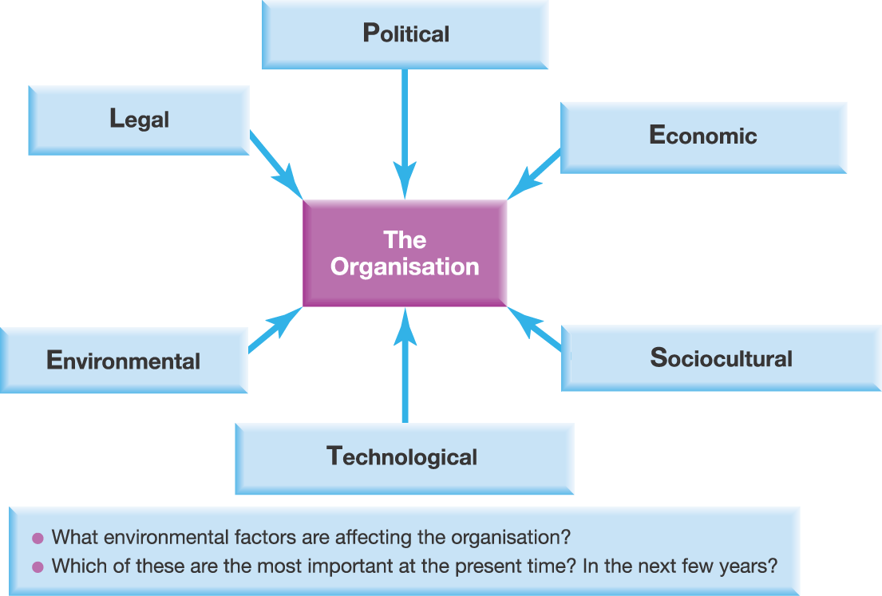
Macroenvironment – PESTEL (1)
Exhibit 2.2
Johnson, Scholes & Whittington (2005)
Exploring Corporate Strategy, 7th Edition, Pearson Education

Slide 15
Strategic Position (2)
Strategic Capability of the Organisation
  Resources and Competences
  Strengths and Weaknesses
Expectations and Purposes
  Corporate Governance,
  Stakeholders,
  Ethics and Culture
  Sources of Power and Influence
  Communication of Purpose: Mission and Objectives
Notes:
To whom the managers are answerable

Slide 16
Strategic Choices
Understanding the underlying bases for future strategy at both the business unit and corporate level and options for developing strategy in term of both the direction and method of developing

Slide 17
Strategic Choices
Bases of competitive advantage at business level
Competitive advantage from customers and market
Scope of activities at corporate level
  Portfolio
  Market spread, e.g. international
  Value added by corporate parent (parenting)
Directions and methods of development
  Directions: Product/Market
  Methods: Internal/organic, M&A, strategic alliances

Slide 18
Strategy into Action
Strategy into action is concerned with ensuring that strategies are working in practice

Slide 19
Strategy into Action
Structuring the organisation to support sucessful performance
Includes organization structures,processes and relationships
Enabling success through the way in which separete resource areas of the organization support the strategies.
Managing strategy very often involves change

Slide 20
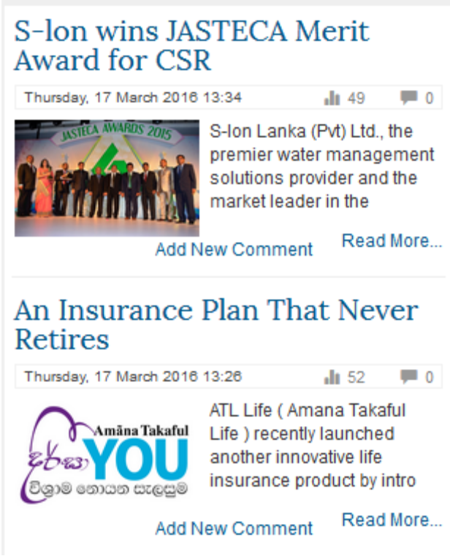
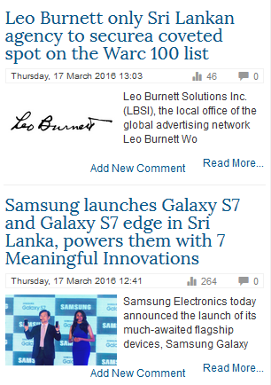
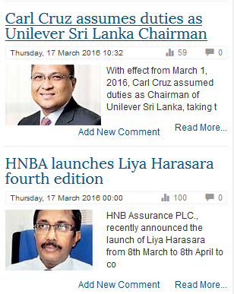


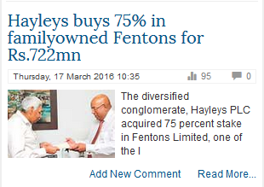
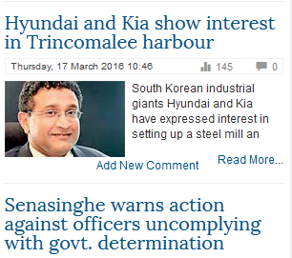

Slide 21
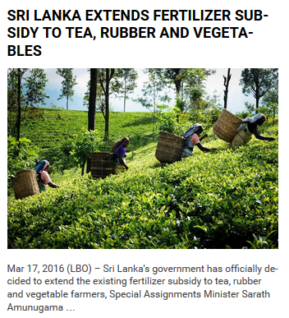

Slide 22
Processes of Strategy Development
Intended strategies
  Deliberate management intent
Emergent strategies
  Develop out of social and political processes in and around organisations
Most strategies are a combination of
intended and emergent processes

Slide 23
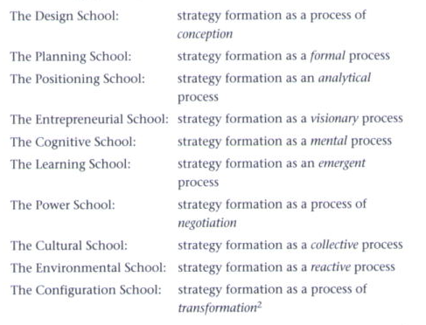

There are many ways of looking at strategy:

Slide 24
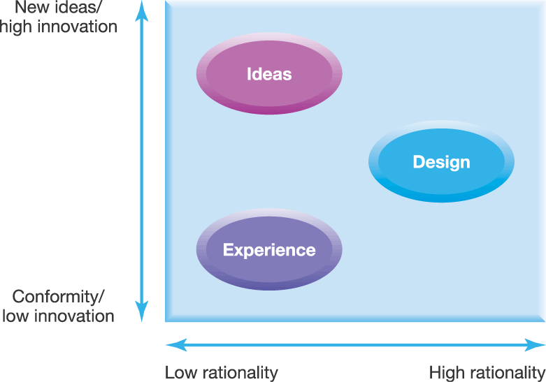
Three strategy lenses
Exhibit I.v

Slide 25
The Strategy Lenses (1)
Strategy as design
  Logical analytical process
  Planned implementation
  Top manager driven
Strategy as experience
  Adaptation of past strategies based on experience
  Influenced by taken for granted assumptions (culture)
  Bargaining and negotiation

Slide 26
The Strategy Lenses (2)
Strategy as ideas
  Importance of variety and diversity for innovation
  Emergent strategy from within and around the organisation
  Top managers create the conditions for this to take place

Slide 27
Strategic Drift
It is the situation where the strategy progressively fails to address the strategic position and of the organization and performance deteriorates

Slide 28
Strategic Drift
The organization undergo a long process through a long period of time of relative continuity of strategy in which an strategy remain unchanged or change incrementally which leads to strategic drift, it is followed by period of flux but in no clear direction, which leads to transformational change in the direction of strategy.

Slide 29
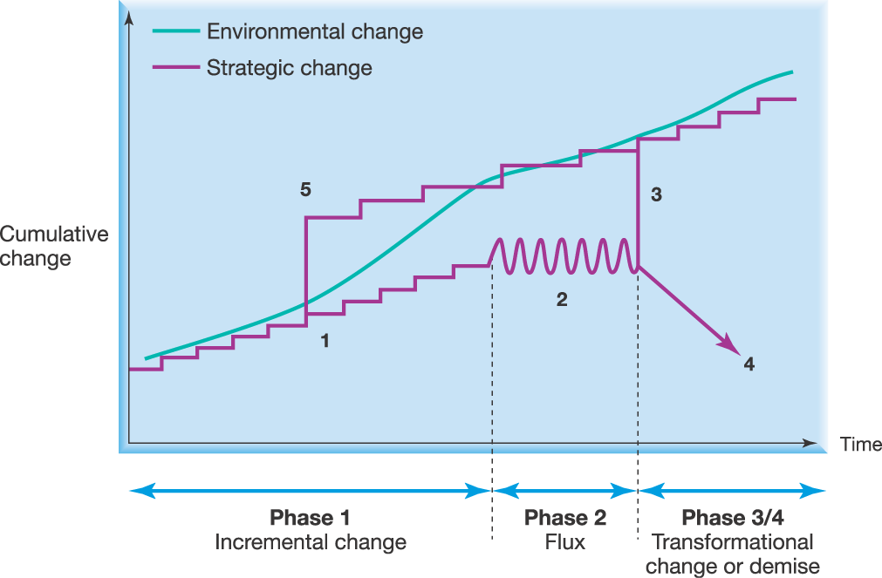
The risk of strategic drift
Irregular surface is punctured equilibrium where punctured equilibrium is the tendency of strategy to develop incrementally with periodic transformational change
Johnson, Scholes & Whittington (2005)
Exhibit 1.4

Slide 30
Discussion Questions
Define what is strategy
Define the characteristics of strategic decisions
Define what is strategic Management
Explain how strategic priorities vary by level: corporate, business and operational;
Understand the basic vocabulary of strategy
Understand what distinguishes strategic management from operational management
Define what is strategic Management
Explain the elements of exploring corporate strategy strategic model and understand how the relative importance of each element will vary with context and circumstances

